Slide 1
Tree Implementations
Chapter 16
Data Structures and Problem Solving with C++: Walls and Mirrors, Carrano and Henry, © 2013

Slide 2
Contents
The Nodes in a Binary Tree
A Link-Based Implementation of the ADT Binary Tree
A Link-Based Implementation of the ADT Binary Search Tree
Saving a Binary Search Tree in a File
Tree Sort
General Trees
Data Structures and Problem Solving with C++: Walls and Mirrors, Carrano and Henry, © 2013

Slide 3
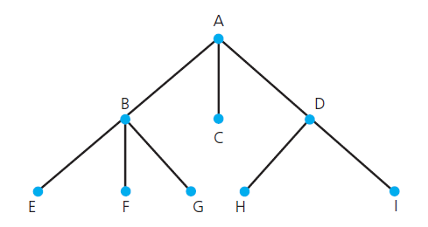
General Trees
FIGURE 16-18 A general tree
Data Structures and Problem Solving with C++: Walls and Mirrors, Carrano and Henry, © 2013

Slide 4
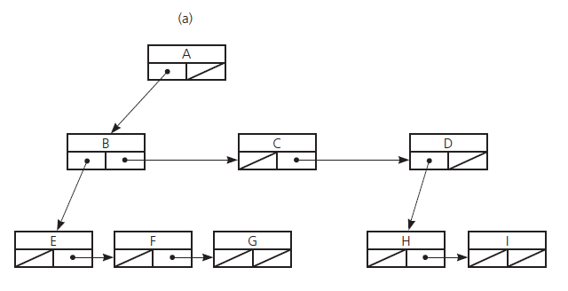
General Trees
FIGURE 16-19 (a) A link-based implementation of the general tree in Figure 16-18 ;
Data Structures and Problem Solving with C++: Walls and Mirrors, Carrano and Henry, © 2013

Slide 5
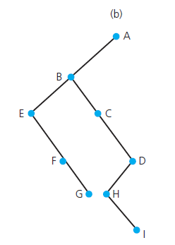
General Trees
FIGURE 16-19 (b) the binary tree that part a represents
Data Structures and Problem Solving with C++: Walls and Mirrors, Carrano and Henry, © 2013

Slide 6
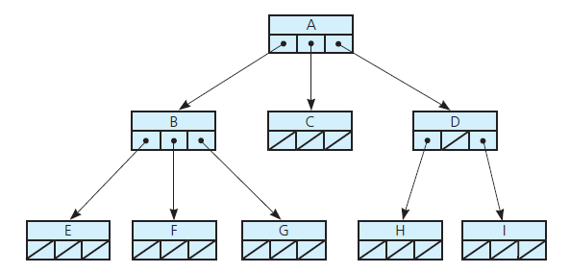
General Trees
FIGURE 16-20 An implementation
of the n -ary tree in Figure 16-18
Data Structures and Problem Solving with C++: Walls and Mirrors, Carrano and Henry, © 2013

Slide 7
End
Chapter 16
Data Structures and Problem Solving with C++: Walls and Mirrors, Carrano and Henry, © 2013

